Slide 1

PRESENTED BY: >ELONDO PRINCE(L) >ARREY EYONG BRIAN >EMIL SHALANYUY >NESTOR NGWA >PRINCESS PRECIOUS >JOSHIAN RUSEL >DERICK AMBELEM
PROJECT NAME: CAMER_TECH
Subtitle:
Revolutionizing Technical Support in Cameroon
DATE: 28 AUG 2024

Slide 2
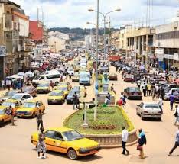
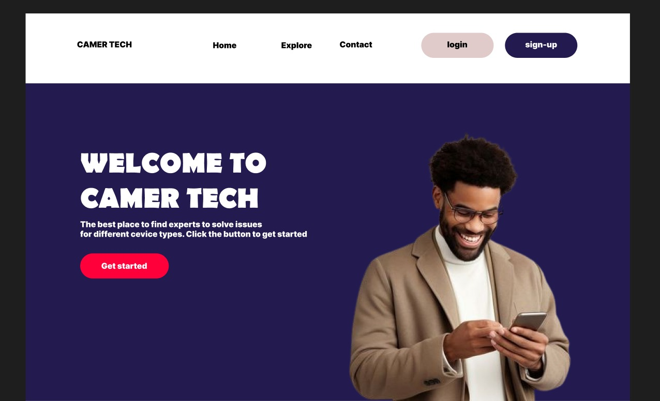
Introduction:
Problem Statement: "Difficulty accessing technical support and exposure to theft in large markets."
Solution: "CAMER_TECH is a platform that allows users to book technicians from their homes and rate their services."

Slide 3
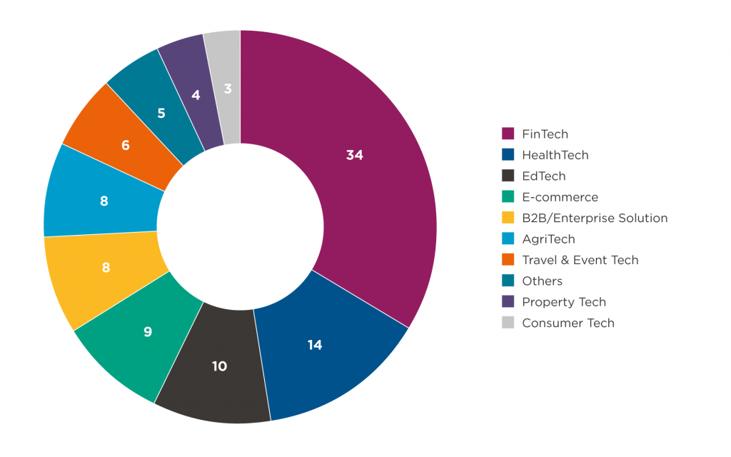
Market Overview:
The tech support industry in Cameroon faces challenges, including access and security.
Market Size and Growth Potential

Slide 4
Target Market:
bussiness owners it grants them to efficient and fast instalation of their systems and tech configurations.
on the other hand for home owners it grants them safety since as service is delivered at door step

Slide 5
Unique Selling Proposition (USP):
>"CAMER_TECH offers secure, convenient, and reliable technician services directly to users’ homes."
>"Users can book, track, and rate technicians easily."

Slide 6
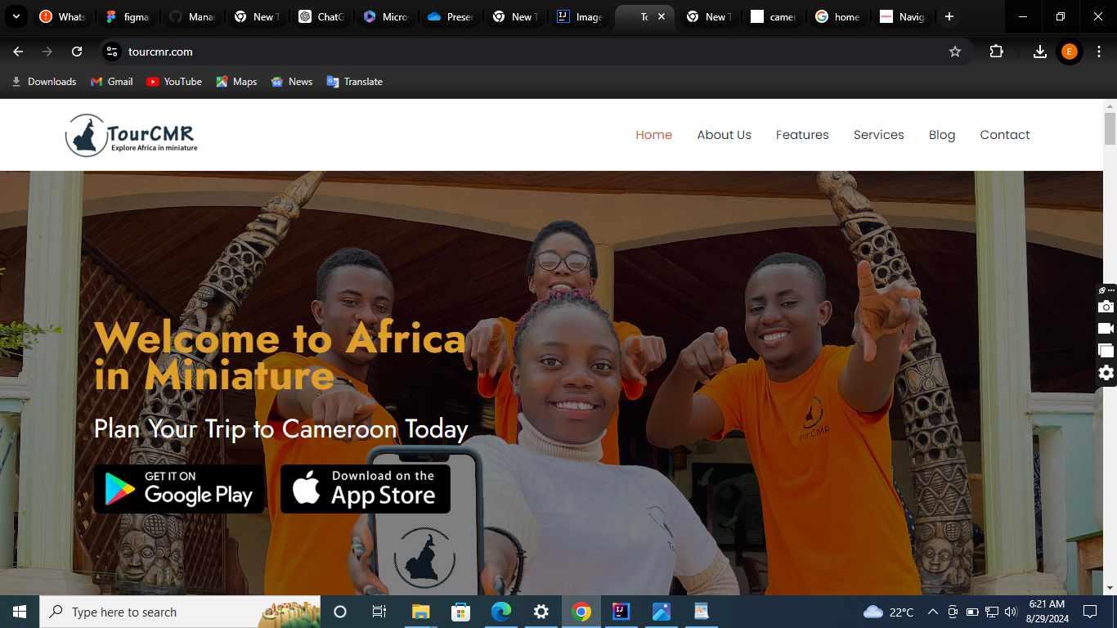
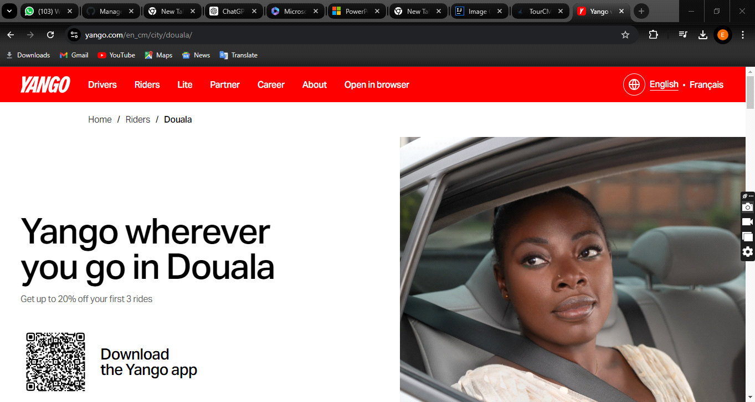
Competitive Analysis:
.
Competitors: Tour Cameroon
Yango Booking:

Slide 7
CAMER_TECH Advantages:
>Saves time,
>reduces theft,
>cheaper
>and highly secured.

Slide 8
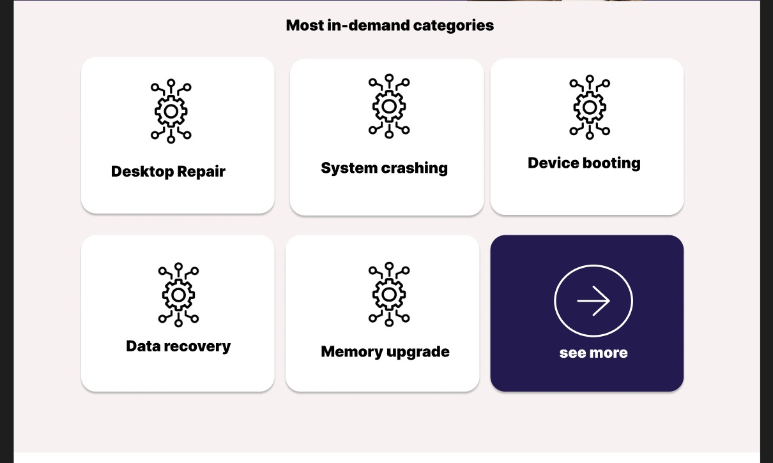
Key Features
Technicians’:

Slide 9
Add a Slide Title - 4

Slide 10
Add a Slide Title - 5

